Slide 1

Gemini API Developer Competition app Developer name: Srijon Mandal School: Amador Valley High School, Pleasanton, CA
Overview: A Gen-AI powered App that leverages multimodal Google Gemini API to assist medical professionals in diagnosing and monitoring autistic patients.
Github Code link: video link:

Slide 2


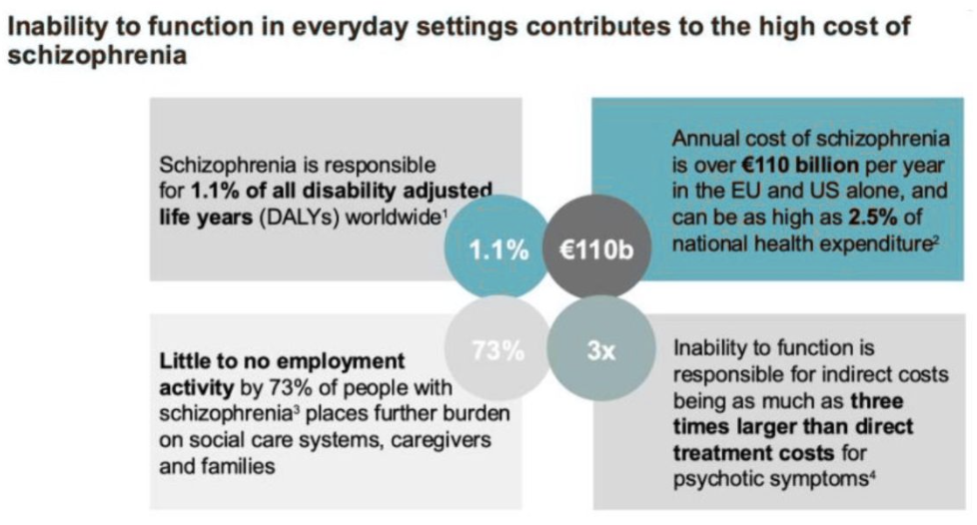
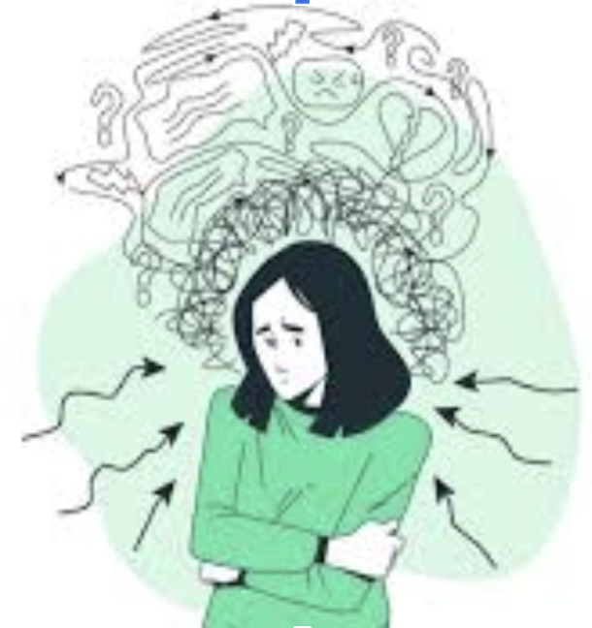
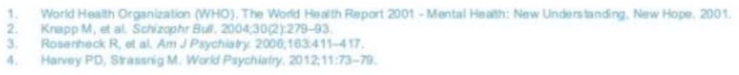
The Problem: Schizophrenia - A Lifelong Brain Disorder and Social Withdrawal
Schizophrenia is a complex and chronic mental health disorder marked by symptoms such as delusions, hallucinations, disorganized thinking and impaired social functioning, often co-occurs with depression, anxiety disorders, and substance abuse.
The symptoms not only significantly impact individual’s functioning of daily life, but also pose a risk of harm to others.
Early intervention, comprehensive treatment approaches, and support from healthcare professionals, family, and community resources are essential in addressing the needs of individuals living with schizophrenia, but there is no existing effective solution.
Global Impact
Global Prevalence
Economic Burden
1% of the global population
(~20M worldwide) affected
Source: World Health Organization

Slide 3
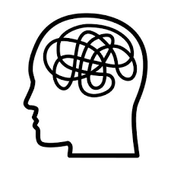





The Problem: Schizophrenia - unique challenges
Symptom Complexities
Suicide Risk
Harm to others
Chronic Mental Health
~5-10% of patients dying by suicide
Source: Schizophrenia Bulletin
~80% are socially isolated - patients may pose a risk of harm to others, particularly if they experience paranoid delusions or command hallucinations. This stigma leads to social isolation, and barriers to accessing necessary treatment.
Source: National Institutes of Health
~80% experience multiple episodes of the illness over their lifetime
Source: National Institute of Mental Health
Clinical Inadequacy
Treatment Gap
Diagnostic Challenges
Healthcare Overutilization
~50% do not receive appropriate care. In low- and middle-income countries, up to 90% are untreated.
Source: World Health Organization
~ 30% misdiagnosis rates reported in some clinical settings
Source: Journal of Clinical Psychiatry
~50% hospital readmission rates within one year of discharge.
Source: National Institutes of Health
** NIMHANS (National Institute of Mental Heath and Neurosciences) Schizophrenia Clinic, Bangalore patients-admins-consultants survey reconfirms some of the above research findings.

Slide 4

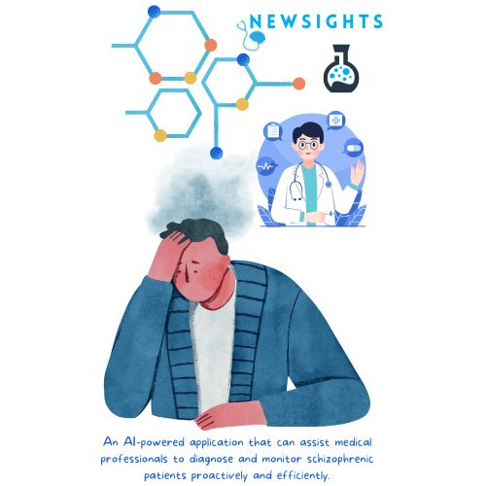
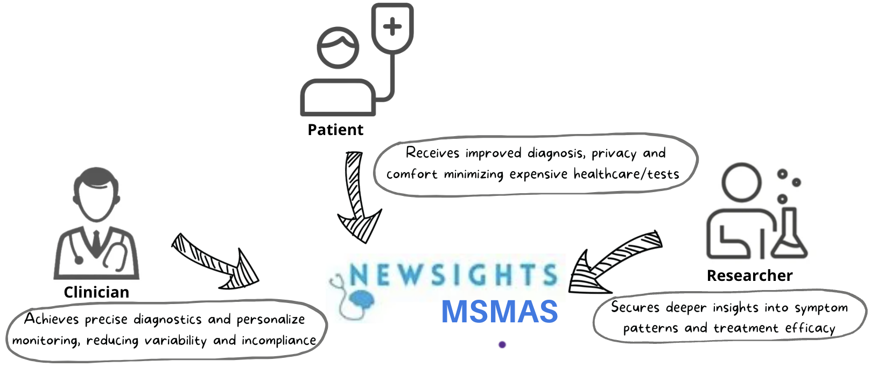
AI Concept: - Multimodal Schizophrenia Monitoring & Analysis System
The primary goal is to develop a Multimodal Schizophrenia Monitoring & Analysis System (MSMAS) that leverages advanced AI technologies to assist medical professionals by providing a more standardized, objective, and efficient method of diagnosing and monitoring schizophrenic patients.
This application will analyze multimodal data inputs - video recordings, speech patterns, and textual information from patient interactions to detect and predict symptom patterns and severity, aiding medical professionals in making informed treatment decisions.
Users & Use Cases

Slide 5
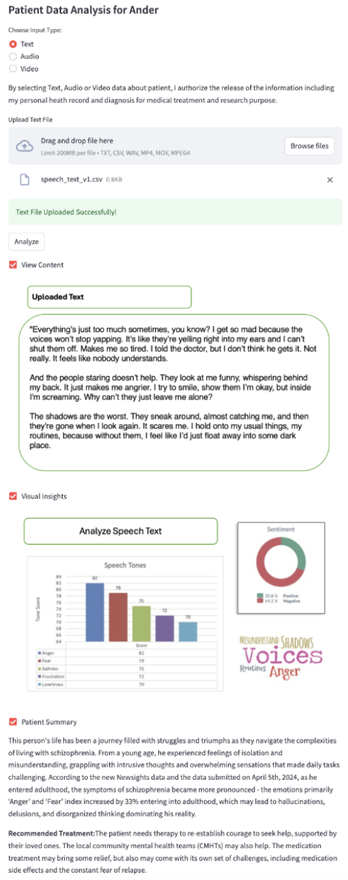
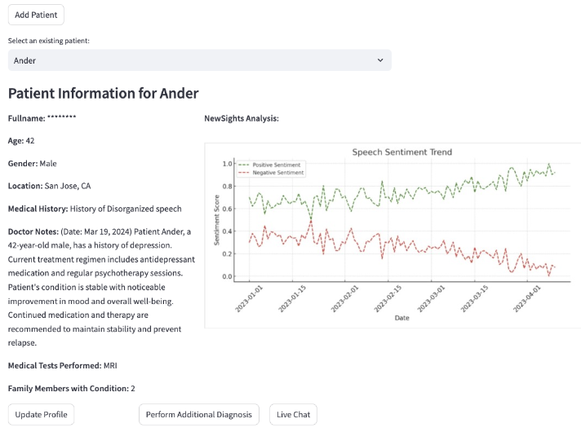


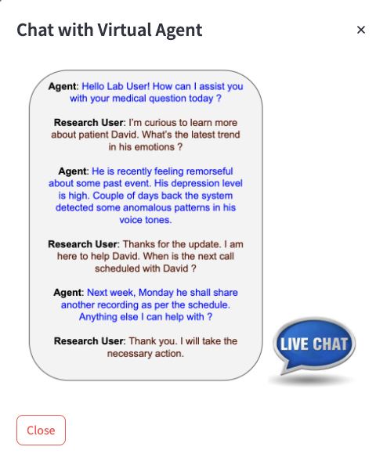
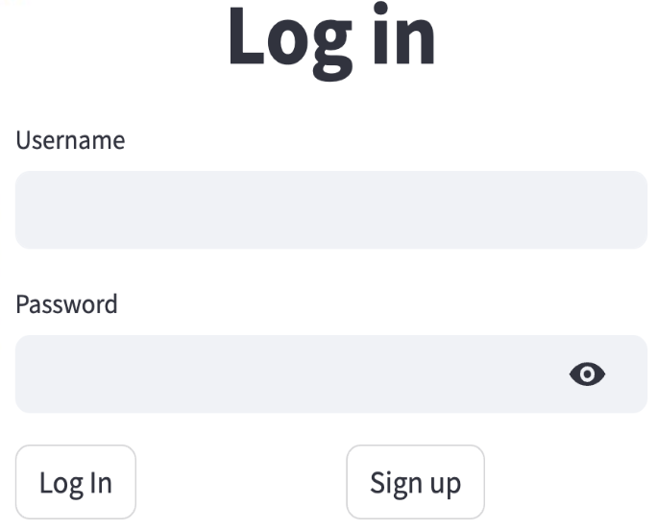

Clinicians Use Cases
Clinicians
Login Page
Home Page
views patient’s insights: anomalies and trends. Patient name is masked and never exposed - HIPAA (DISHA in India) compliant.
Patient Diagnosis Page
uploads patient’s info (text, audio or video) and analyzes to detect and predict symptom patterns and severity, and gets recommended treatment. User consent to use
patient data is captured.
logs in
Future Use Cases: symptom prediction and preventive treatment
using rich historical patient insights derived by above flow
asks questions to Virtual Agent
(which leverages knowledge base)

Slide 6
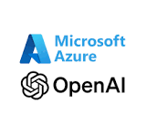





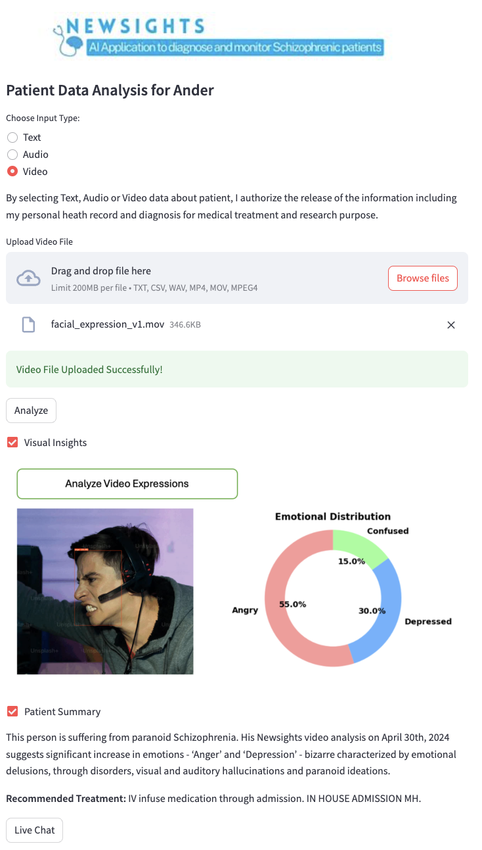
Use of Artificial Intelligence
Advanced AI Technologies are used for content synthesis and Q&A:
OpenAI Prompt Engineering and Whisper: For processing and understanding natural language inputs and converting speech to text with high accuracy.
Hugging Face Transformer and OpenAI for Emotion Detection: To interpret emotional states from text, providing insights into the patient's mental state.
Emotion Detection from Video using YOLOv7 and PyTorch: To analyze facial expressions and body language from video data, offering another layer of emotional and symptomatic analysis.
Data Visualization and Analysis:
Data is presented using intuitive visualizations such as trend lines, scatter plots, and histograms, enabling clear tracking of progression or improvement over time. It is planned to automate insights and create charts using Gen-AI.
Application of AI for Prescriptive Analytics:
ML Algorithms will be used to cluster the insights and predict certain behaviour and generate recommendations.
AI-driven Knowledge Management:
Open-AI and RAG based Virtual Agent: It assists researchers and medical professionals by answering queries related to the patient data and broader schizophrenia research, facilitating an interactive, learning-enhanced environment.

Slide 7
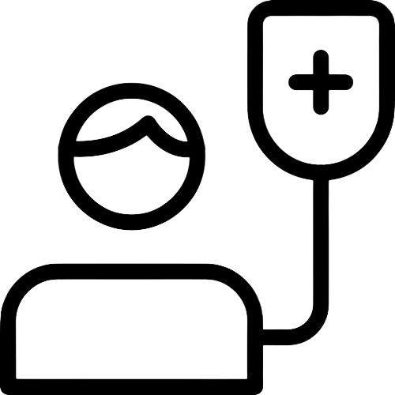




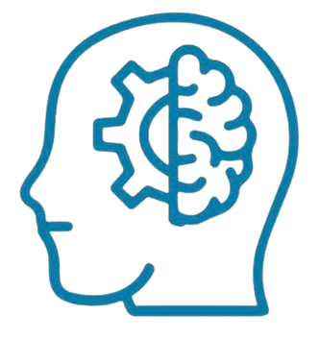



Impact
Empowering Healthcare Providers: NewSights MSMAS uses AI to analyze complex, multimodal data, which minimizes the subjective bias inherent in traditional psychiatric evaluations. The standardized data driven diagnosis ensures accurate and timely identification of schizophrenia.
Enhanced Monitoring and proactive treatment: The continuous and non-invasive monitoring capabilities of the app allows for the detection of subtle changes in symptoms that might not be evident during routine clinical visits, enabling proactive management of the condition, potentially preventing severe episodes and reducing emergency interventions.
Improved Health Outcomes: With more accurate diagnostics and personalized treatment plans, reduced symptoms, and improved quality of life.
Healthcare Savings: Minimizes hospitalization/tests cost
Social Inclusiveness: standard unbiased diagnosis and treatment eliminate social stigma.
Convenience: privacy and comfort in treatment
Schizophrenia Patients
Clinicians
Research and development of new treatment methodologies: The rich dataset generated by tool can be a valuable resource for ongoing research into schizophrenia. The rich dataset ensures accuracy, scale and global diverse sample.
Faster feedback loop: improved connection with healthcare providers and patients enables faster research feedback loop.
Global Reach and Accessibility: Given its digital and AI-driven nature, the app can be deployed across different regions, including underserved areas with limited access to specialized psychiatric services.
Optimized National Health Expenditure: Minimizes hospitalization and treatment cost managing the chronic mental health disorder. NewSights MSMAS will enable better expenditure forecasting. It also optimizes healthcare resource utilization.
Social Inclusiveness and productivity: Recovered sociable and employable individual increases social value.
Researchers
Global
Community

Slide 8
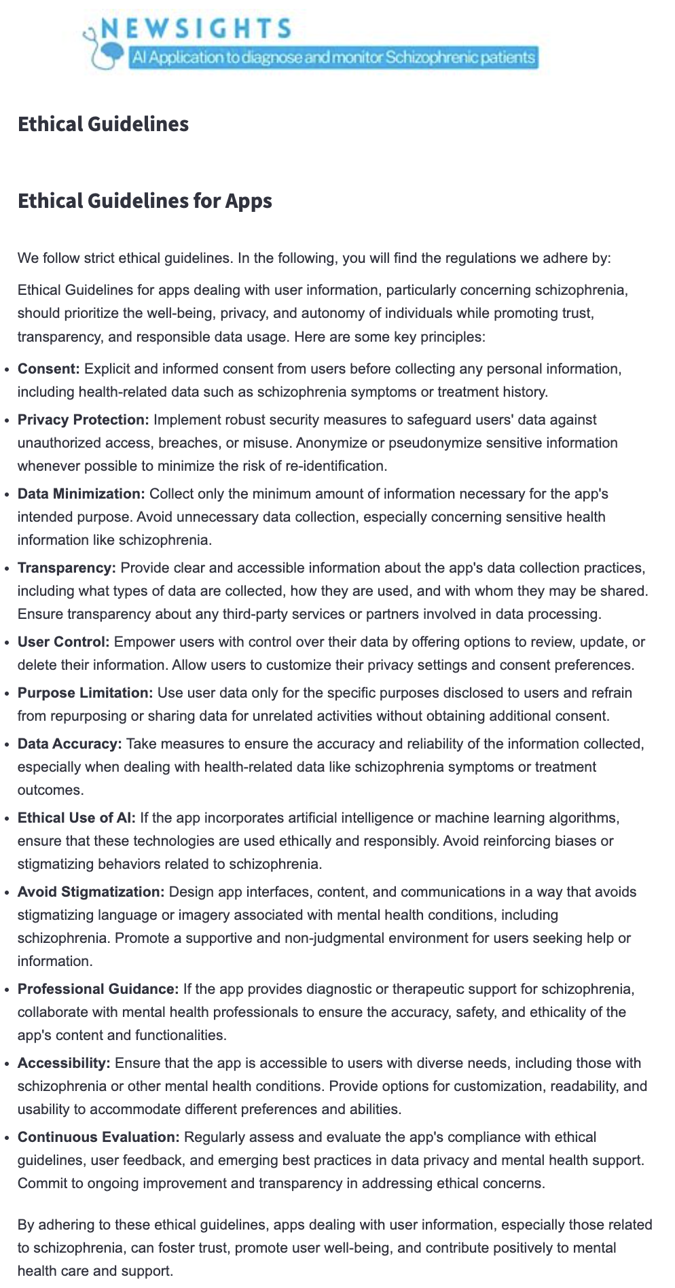






Ethics
Privacy & Security
Inclusiveness
Fairness
Reliability & Safety
MSMAS is designed to provide equitable treatment recommendations regardless of a patient's background. The AI algorithms are internally trained by Azure Open AI on diverse datasets to minimize biases related to age, gender, ethnicity, or socioeconomic status.
AI technologies ensures accuracy and dependable outputs in clinical settings.
Patient names are anonymized/masked, and the recommendations are always reviewed and supplemented by human clinicians, ensuring patients’ safety. The app flags data that deviates from norms.
NewSights team ensures that all services run securely in Azure VPC and data is encrypted. User login will be strictly controlled and audited. User information will be used in AI Models, LLM and Analytics only based on user consent, giving users controls to choose how their medical data is used.
The tool caters to patients from diverse linguistic and cultural backgrounds by supporting multiple languages and adapting interfaces to different cultural contexts. This approach helps reduce healthcare disparities by making advanced healthcare technologies accessible to a broader population.
Published on the website
We provide clear documentation and explanations of how the AI models operate, what data they use, and how decisions are made. The documentation ensures global explanation how the treatment recommendation works and local explanation of specific medication/therapy recommendation, further ensuring interpretability. This transparency ensures that clinicians understand the basis of the AI’s recommendations, enabling informed decision-making.
Transparency
NewSights ensures that decisions made by the app can be audited and traced back to specific data inputs and AI processes. All operations performed by the user are logged. Regular performance reviews and updates are conducted to assess the impact of the AI, and stakeholders are involved in continuous dialogue to discuss outcomes and potential improvements.
Accountability

Slide 9

Cybersecurity
Data Encryption
All data, whether at rest or in transit, is encrypted using advanced encryption protocols. This ensures that patient data is secure during transmission and persistence.
Access Control
User, Roles and Groups will be created for access control.
Audit & Compliance
All access info will be stored in audit logs - HIPAA ( /DISHA/equivalent) Compliant.
Secure Development Lifecycle
Secure Azure ML Workbench and Github will be used for development.
Incident Response Plan
Microsoft Azure Sentinel can be used for detecting and managing cyber attacks.
Data Integrity Checks
All user details, user insights, data analysis operations will be only used for research and diagnosis, will be maintained separately and will not be shared publicly or with other users.
Training & Awareness
All types of User Manuals and Documents will be provided.

Slide 10
Sources
Schizophrenia Statistics: https://neurotorium.org/slidedeck/schizophrenia-epidemiology-and-burden/
Text Classification using Azure AI: https://github.com/Azure/azureml-examples/blob/main/sdk/python/foundation-models/system/inference/text-classification/entailment-contradiction-batch.ipynb
Ethical AI https://go.microsoft.com/fwlink/p/?linkid=2235870
Implement RAG https://github.com/Azure/azureml-examples/tree/main/sdk/python/generative-ai/rag/notebooks
Prompt Flow https://github.com/Azure/azureml-examples/tree/main/sdk/python/generative-ai/promptflow
Multi-Modal Object Tracking\ https://github.com/Azure/azureml-examples/tree/main/cli/foundation-models/system/inference/video-multi-object-tracking
Index the results and allow the Lab users search the results: https://github.com/Azure/azureml-examples/tree/main/sdk/python/generative-ai/rag/notebooks

